Slide 1
Introduction to R Workshop
Session 4
Visualize Data
May 6, 2019

Slide 2
7:00 am - 8:00 am | BREAKFAST - BALLROOM LOBBY - 2ND FLOOR
8:00 am - 8:10 am | Instructor Instructions
8:10 am - 9:50 am | Introduction to R and RStudio for Reproducible Reporting
9:50 am - 10:10 am | REFRESHMENT BREAK - BALLROOM LOBBY - 2ND FLOOR
10:10 am - 11:50 am | Data Wrangling
12:00 pm - 1:00 pm | LUNCH - BALLROOM LOBBY - 2ND FLOOR
1:00 pm - 2:50 pm | Data Understanding
2:50 pm - 3:10 pm | REFRESHMENT BREAK - BALLROOM LOBBY - 2ND FLOOR
3:10 pm - 5:00 pm | Exploratory Data Analysis
Notes:
In the first block we will introduce ourselves to R and the concepts of reproducible reporting.
First Hour: Getting oriented to the R programming language and basic coding concepts
Second Hour: Learning reproducible reporting practices and tools in R

Slide 3
Goals
Appreciate the importance of visualization as device to generate knowledge about data
Learn how to use ggplot2 to create visualizations from data frames
Objectives
Explain the template to create any graph with ggplot2
Explain how aesthetic mappings relate variables to graphic markings on a plot
Distinguish between setting and mapping aesthetics
Explain how to use a geom function to add a layer to a graph
Distinguish between global and local ggplot2 settings
Notes:
In this first hour our goal is to develop some familiarity with the R programming language as well as some basic proficiency with coding fundamentals as they are implemented in R.
We will log into the R environment and learn about the how to execute code in the console.
Upon this we will layer concepts of functions and objects. We will use some basic functions and make some objects.
Finally we will access and interact with a dataframe.

Slide 4
Your Turn 1
Consider the orders data frame. How do you think order_time and result_time are related to each other?
Pair up and discuss.
Notes:
Last time we looked at a data set with ESR lab values from CERNER. How do you think they are distributed? Let’s take a quick minute to discuss.

Slide 5
Your Turn 2
Type the following code in the console to make a graph.
Pay attention to the spelling, capitalization, and parentheses!
ggplot(data = orders) +
geom_point(mapping = aes(x = order_time, y = result_time))

Slide 6
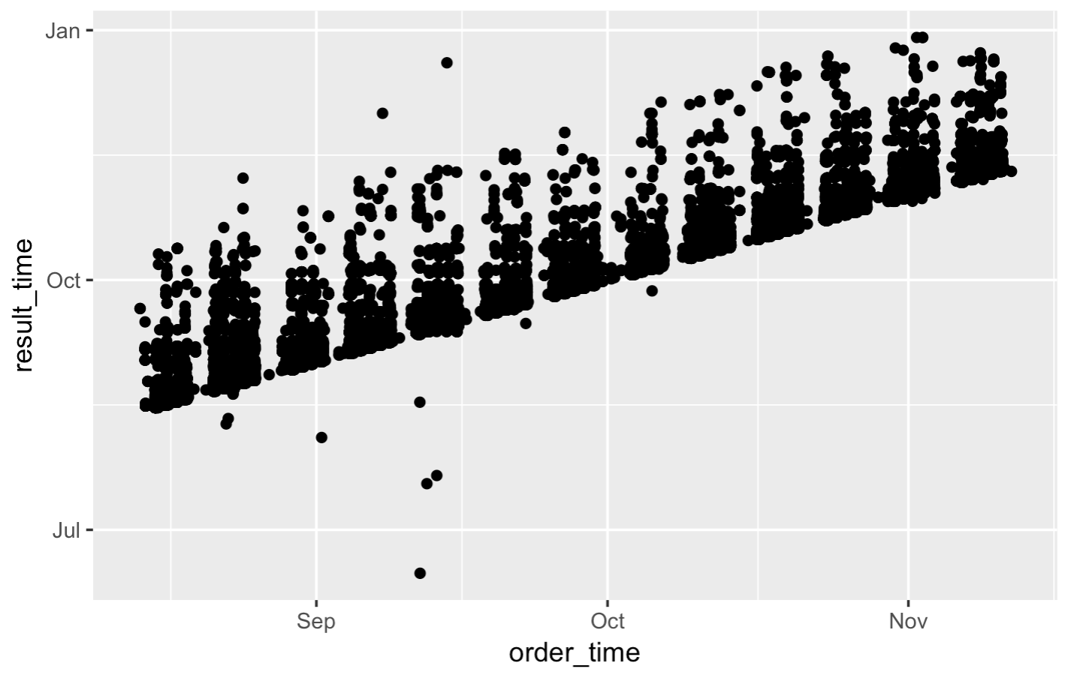
ggplot(data = orders) +
geom_point(mapping = aes(x = order_time, y = result_time))
Notes:
You might have expected that it’s normal or bimodal (with normal and abnormal values).
Instead the maximum is close to zero and there’s a long tail on the right, with no clear separation of normal and abnormal values.
This is not at all clear from looking at a table with almost 250,000 rows.
The point of this exercise is that you might have preconceived ideas about your data, but they often aren’t accurate. Being able to visualize data quickly is critical for understanding.
Delete from PDF deck

Slide 7
When you run this code, you will get what looks like an error but is actually just a message. R lets you know that some of the rows did not have data for order_time and/or result_time so those points were not plotted.
ggplot(data = orders) +
geom_point(mapping = aes(x = order_time, y = result_time))
Notes:
Warning useful - Good to think about NAs in the dataset

Slide 8
Notes:
We’ll be using the ggplot package for creating graphics. ggplot is part of the tidyverse so it will get loaded when you load the tidyverse metapackage by running library(tidyverse)
GGplot provides a "grammar of graphics" for data visualization. The idea is that you can build any type of graph by specifying the data, a function that specifies the type of graph, and a mapping that describes how the data should be represented as visual marks on that graph.
So there should be a consistent way, or a grammar, to construct any type of graph.
The advantage of ggplot2 over other graphics packages for R is this consistent grammar, which makes it easy to try out a bunch of different ways to display your data without having to change much code.

Slide 9
ggplot()
+ sign
before new line
initialize a plot
with ggplot()
data frame
ggplot(data = orders) +
geom_point(mapping = aes(x = order_time, y = result_time))
mappings inside
aes() function
type of layer
x variable
y variable
Notes:
Here is how you use ggplot.
You can see that we give it a data frame, in this case, our ESR data
We specify the type of graph, or “geom”, in this case, a histogram
And we specify an aesthetic mapping, in this case, saying that we want the variable “Result” which contains results of ESR testing values, on the x axis.
A few more details to note: you always start a plot with the ggplot() function
To connect the ggplot function to the geom function you use a ‘+’ sign which should be put at the end of the line
And the mappings need to go into the aes() function

Slide 10
To make any kind of graph:
1. Choose a “tidy”
data frame
ggplot(data = data_frame) +
geom_function(mapping = aes(mappings))
2. Pick a “geom” function
3. Write aesthetic mappings
Notes:
So that was a lot of information. Let’s try to break it down into a mental model. Here’s a template for making any kind of graph with ggplot2.
Pick a tidy data frame
Choose a geom function
Write aesthetic mappings

Slide 11
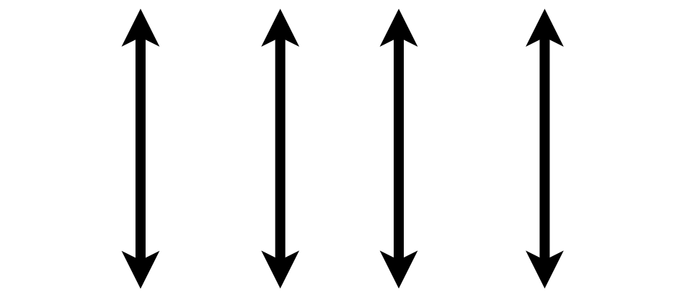
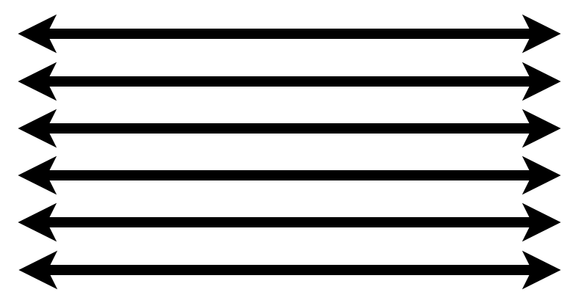
1. Pick a “Tidy” Data Frame
A data set is tidy if:
Each variable is in its own column
Each observation is in its own row
Each value is in its own cell
Notes:
This is a good time to introduce the idea of ”tidy” data that also gives the “tidyverse” its name.
Any data set can take on a lot of different shapes. But there is one shape that is best suited for data analysis, and that shape is called ”tidy.”
The opposite of “tidy” data is often called “messy” and often times one of the first data analysis tasks is to convert “messy” data into “tidy data.”
Question: do you think that the “orders” data frame is tidy? Why or why not?
A data set is tidy if: each variable is in its own column,
Each case is in its own row
Each value is in its own cell

Slide 12
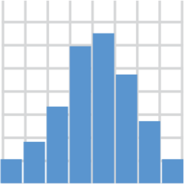
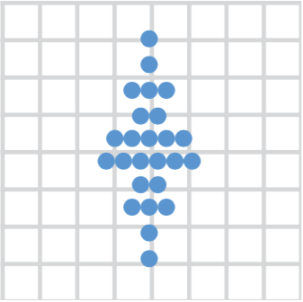
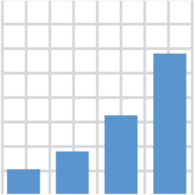

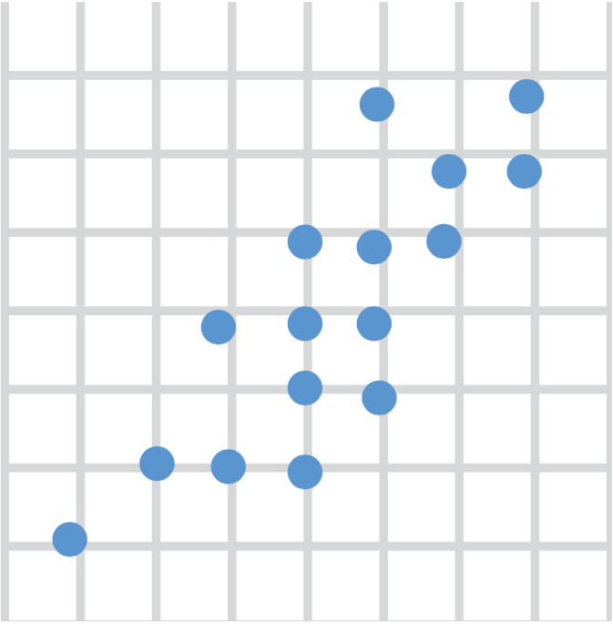
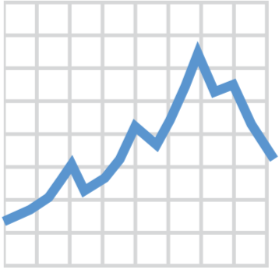
2. Choose a “Geom” Function
geom_histogram()
geom_dotplot()
geom_bar()
geom_boxplot()
geom_point()
geom_line()
Notes:
There are many different ways data can be displayed, and to tell ggplot what type of graph you want you pick a geom_ function.
Here are the top 6 most useful geom functions for visualizing clinical data, but there are many more. With these 6 you can make histograms, bar plots, scatter plots, dot plots, boxplots, and line plots.

Slide 13
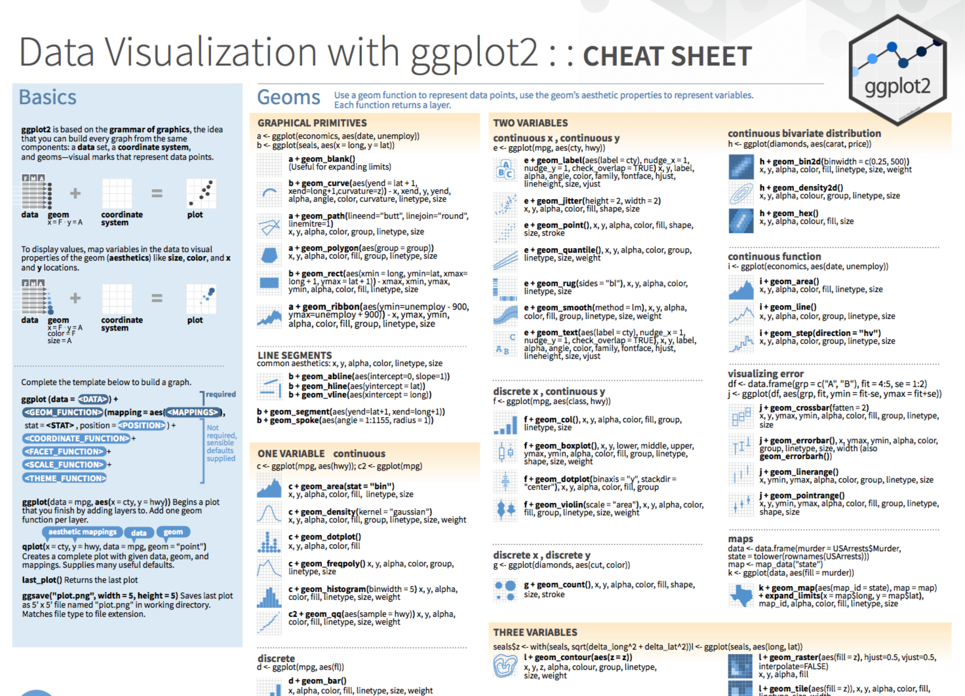
Notes:
The ggplot2 Cheat Sheet (hand out) is great to have on hand as you’re exploring your data with ggplot.

Slide 14
Aesthetics
From Fundamentals of Data Visualization, by Claus Wilke, licensed under CC-BY-NC-ND

Slide 15
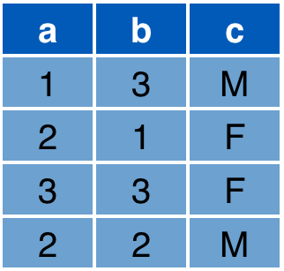

3. Write Aesthetic Mappings
aes(x = a, y = b, color = c)
Data frame
Graph
y
x
Notes:
So now we've picked a tidy data frame, we've picked a geom function, what's left now is to write aesthetic mappings.
So what's an aesthetic mapping? An aesthetic mapping is a definition of how you what the variables of your data frame represented as graphical markings on your plot.
For example, consider this data frame with 3 columns a, b, c, and this x/y graph.
* The aesthetic mapping above defines that x axis value of each marking should come from the "a" column
The y axis value from the "b" column
And since we’re now out of axes, we can define that the color should come from the "c" column. R figures out a reasonable color scale but you can fine tune this.
As a result, you get the expected graph.

Slide 16
Your Turn 3
Consider the 6 aesthetics shown just previously. All aesthetics can be used for discrete variables, but only some can be used for continuous variables.
Which aesthetics can be used only for discrete variables?
Color
Line type
Shape
B + C
A + B + C
Notes:
Correct answer: D
Color – can be continuous gradients, as in gene expression heatmaps
(If cts vs discrete are not clear, review orders dataset)

Slide 17
Your Turn 4
Open 04-visualize.Rmd. Work through the exercises of the section titled “Your Turn 4.”

Slide 18
Setting vs Mapping Aesthetics

Slide 19
How would you make this plot?

Slide 20
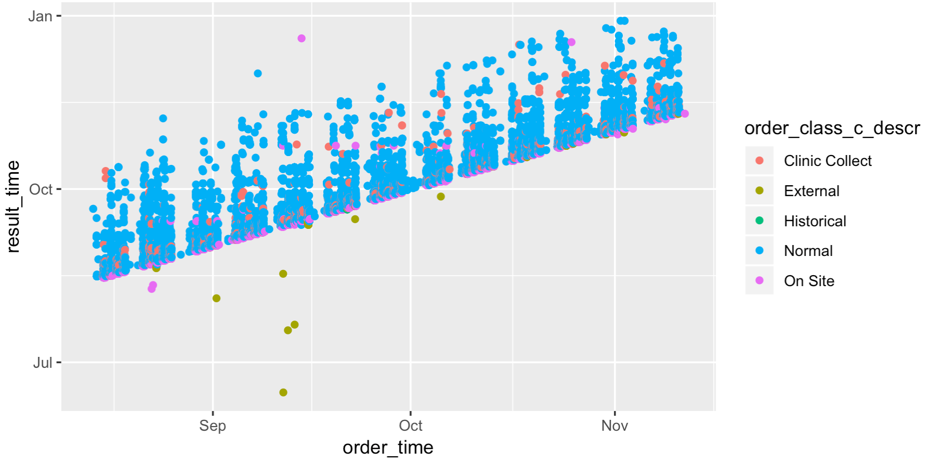
Inside of aes():
map an aesthetic to a variable
ggplot(data = orders) +
geom_point(mapping = aes(x = order_time, y = result_time, color = order_class_c_descr))

Slide 21
Outside of aes():
set an aesthetic to a value
ggplot(data = orders) +
geom_point(mapping = aes(x = order_time, y = result_time), color = "blue")

Slide 22
ggplot(data = orders) +
geom_point(mapping = aes(x = order_time, y = result_time, color = order_class_c_descr))
ggplot(data = orders) +
geom_point(mapping = aes(x = order_time, y = result_time), color = "blue")

Slide 23
Geom Functions

Slide 24
How are these plots similar?
Same: x axis, y axis, data

Slide 25
How are these plots different?
Different geometric object (“geom”) used to represent the data
Notes:
Different way to display the data…
Left: one point
Right: a smoothened line

Slide 26
ggplot(data = data_frame) +
geom_function(mapping = aes(mappings))

Slide 27
Your Turn 5
Open 04-visualize.Rmd. Work through the exercises of the section titled “Your Turn 5.”

Slide 28
Global vs Local Settings

Slide 29
Inside of geom_ function: apply locally to only the current layer
Inside of ggplot(): apply globally to every layer
ggplot(data = orders) +
geom_point(mapping = aes(x = order_time, y = result_time)) +
geom_smooth(mapping = aes(x = order_time, y = result_time))
ggplot(data = orders, mapping = aes(x = order_time, y = result_time)) +
geom_point() +
geom_smooth()
Notes:
Very wordy.

Slide 30
How would you make this plot?
ggplot(data = orders, mapping = aes(x = order_time, y = result_time)) +
geom_point(mapping = aes(color = order_class_c_descr)) +
geom_smooth(color = "black")

Slide 31
What Else?

Slide 39
ggplot(data = data_frame) +
geom_function(mapping = aes(mappings)) +
theme_function +
scale_function +
facet_function +
coordinate_function +
...
Required
Optional

